Slide 1

Reconocimiento de Patrones
Domingo Mery
Departamento de Ciencia de la Computación
Escuela de Ingeniería
Universidad Católica de Chile
HoG - Human Detection
[ Capítulo 2 ]

Slide 2

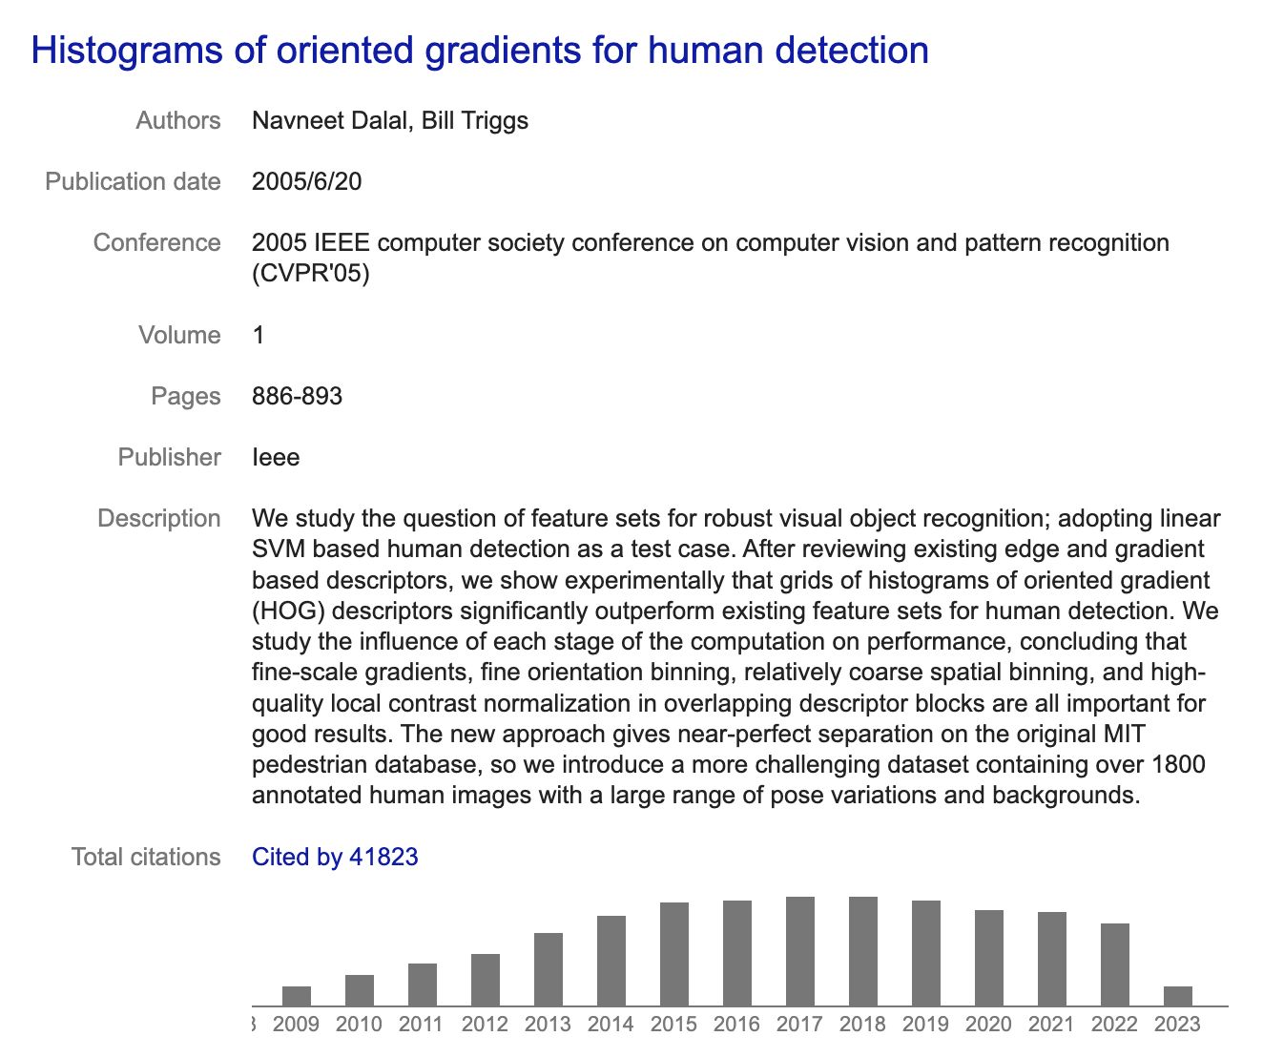
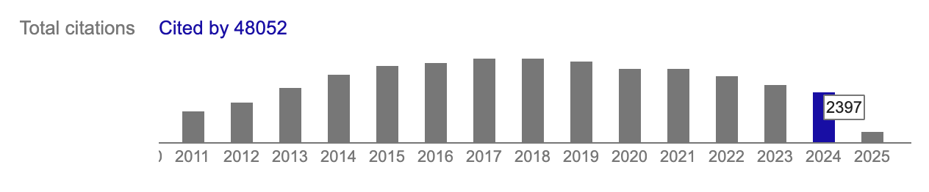
HoG: Histogram of oriented gradients
Navneet Dalal
N Dalal, B Triggs: Histograms of oriented gradients for human detection. Computer Vision and Pattern Recognition, (CVPR 2005).

Slide 3
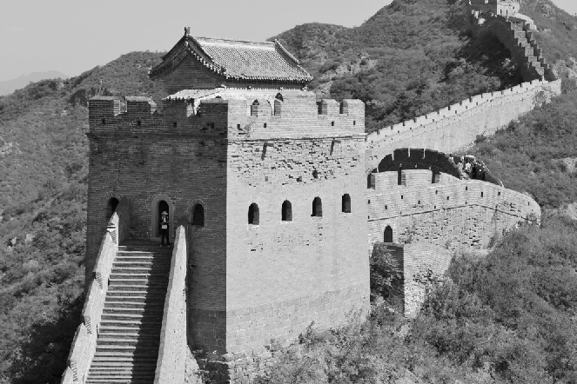
Histogram of Gradients
Gradient in x
direction
G_{x}
Gradient in y
direction
G_{y}

Slide 4
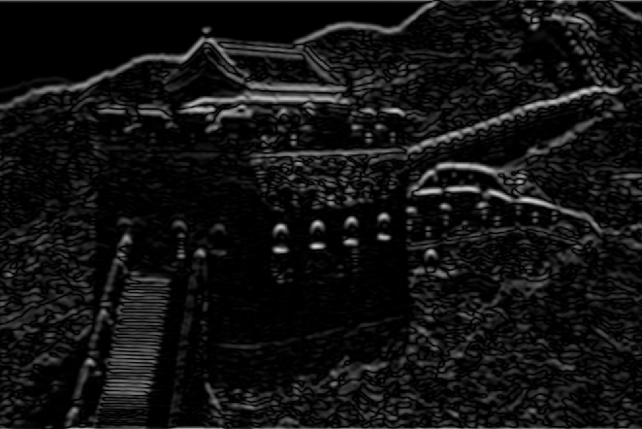
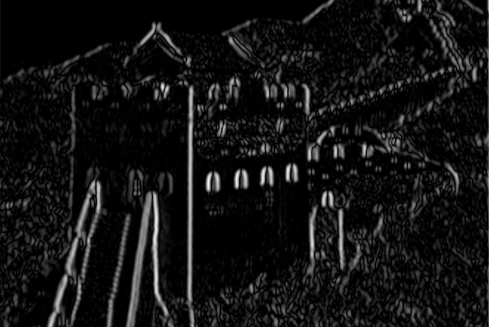
Histogram of Gradients
G_{x}: Gradient in x direction
Magnitude
R
= sqrt(G_{x}²+G_{y}²)
G_{y}: Gradient in y direction
Angle
A
= arctan(Gy/G_{x})

Slide 5
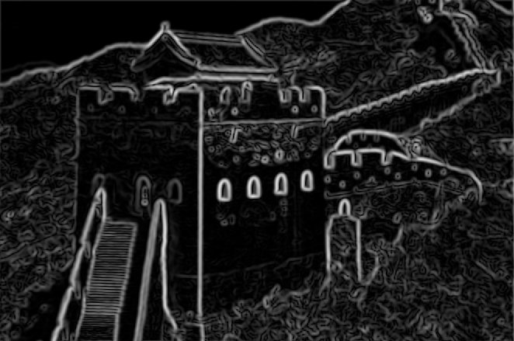
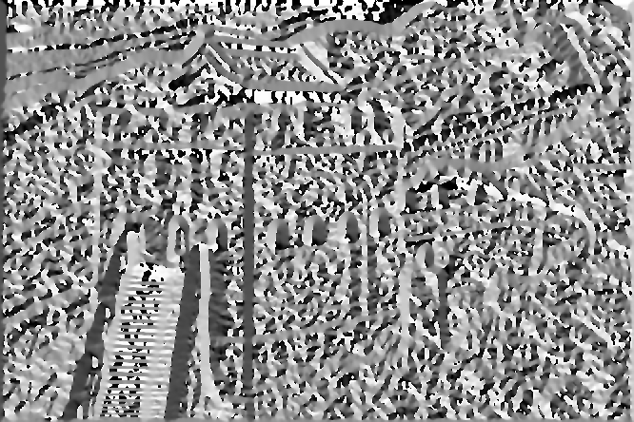
Histogram of Gradients
R: Magnitude
Histogram of 8 directions
3
4
2
A: Angle
5
1
6
8
7
1 2 3 4 5 6 7 8

Slide 6
Histogram of Gradients
R: Magnitude
Histogram of 8 directions
(computation of first bin)
3
4
2
A: Angle
5
1
6
8
7
1 2 3 4 5 6 7 8

Slide 7
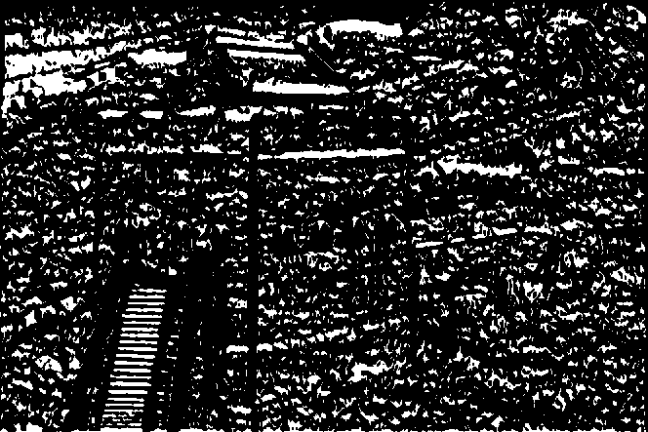
Histogram of Gradients
R: Magnitude
Histogram of 8 directions
(computation of first bin)
3
4
2
22.5º
A: Angle between -22.5º and 22.5º
5
1
-22.5º
6
8
7
1 2 3 4 5 6 7 8

Slide 8
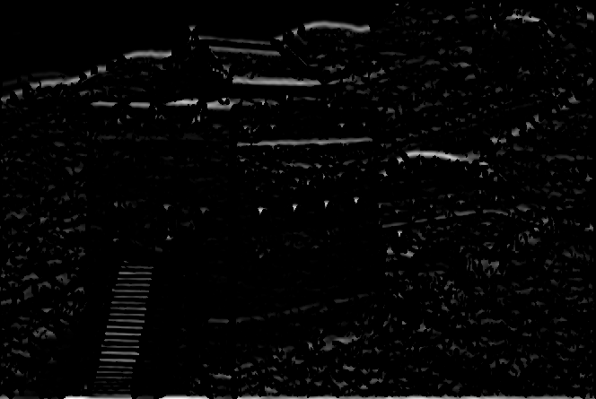
Histogram of Gradients
R: Magnitude in this direction
Histogram of 8 directions
(computation of first bin)
3
4
2
22.5º
A: Angle between -22.5º and 22.5º
5
1
Σ
-22.5º
6
8
7
1 2 3 4 5 6 7 8

Slide 9
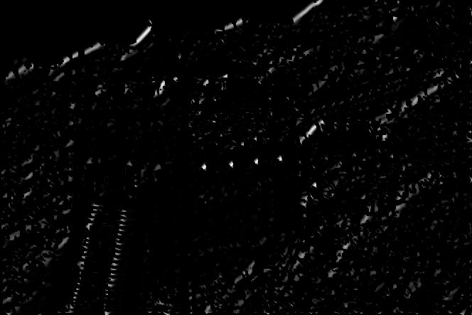
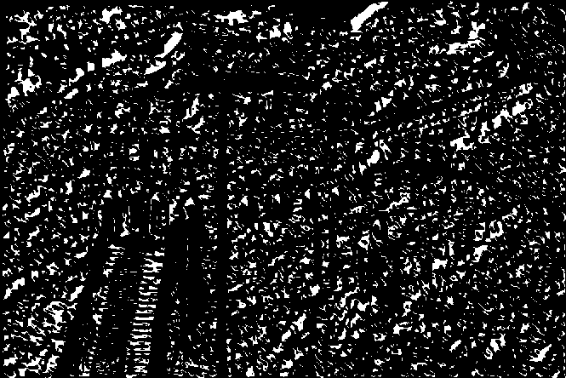
Histogram of Gradients
R: Magnitude in this direction
Histogram of 8 directions
(computation of second bin)
3
67.5º
4
2
22.5º
A: Angle between 22.5º and 67.5º
5
1
Σ
6
8
7
etc.
1 2 3 4 5 6 7 8

Slide 10
Histogram of Gradients
R: Magnitude
Histogram of 8 directions
3
4
2
A: Angle
5
1
6
8
7
1 2 3 4 5 6 7 8

Slide 11
Histogram of Gradients
R: Magnitude
Histogram of 8 directions
3
4
2
A: Angle
5
1
6
8
7
1 2 3 4 5 6 7 8

Slide 12
The descriptor proposed by the authors is a concatenation of HoG in different overlapped partitions

Slide 18
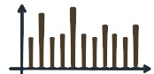
Feature
Extraction
. . .
Descriptor of n elements
n = # cells x # bins

Slide 19


Slide 20
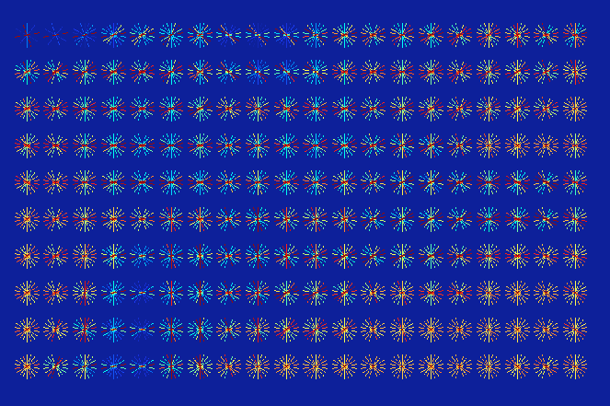

Slide 21
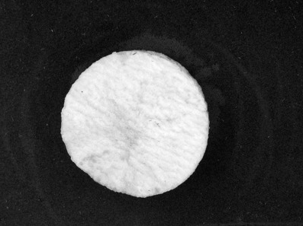
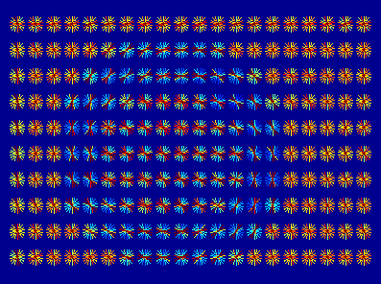
Example using Balu:

Slide 22
How to detect pedestrians using HoG?

Slide 23
The Solution

Slide 24
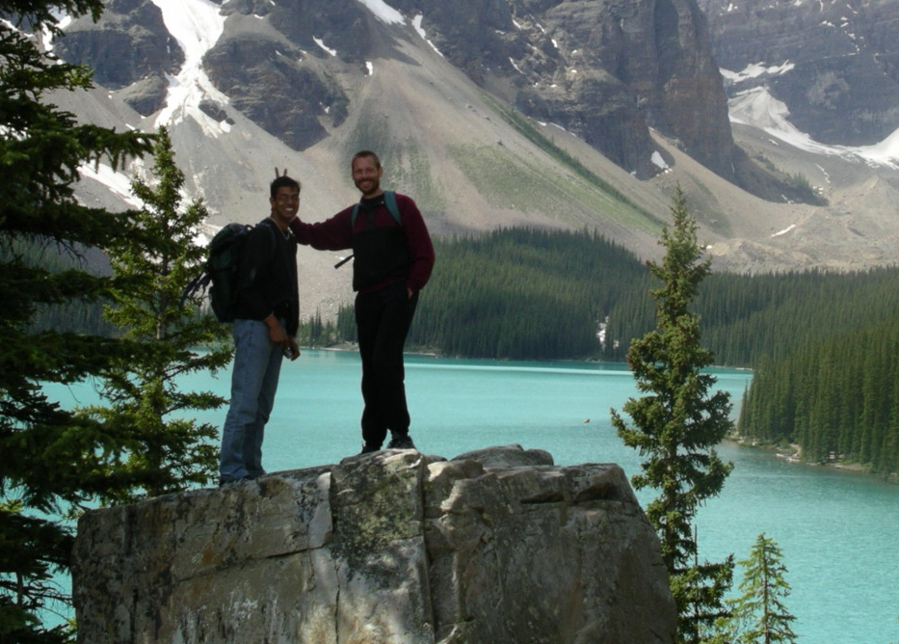
Strategy: Sliding Windows

Slide 25
Strategy: Sliding Windows

Slide 26
Strategy: Sliding Windows
Detection
Detection

Slide 27
The Key-Idea:
Design a classifier that is able to distinguish between
pedestrians from no-pedestrians.

Slide 28
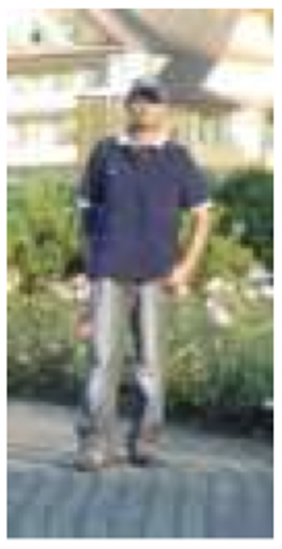
Positive Class: Pedestrians
Pedestrian

Slide 29
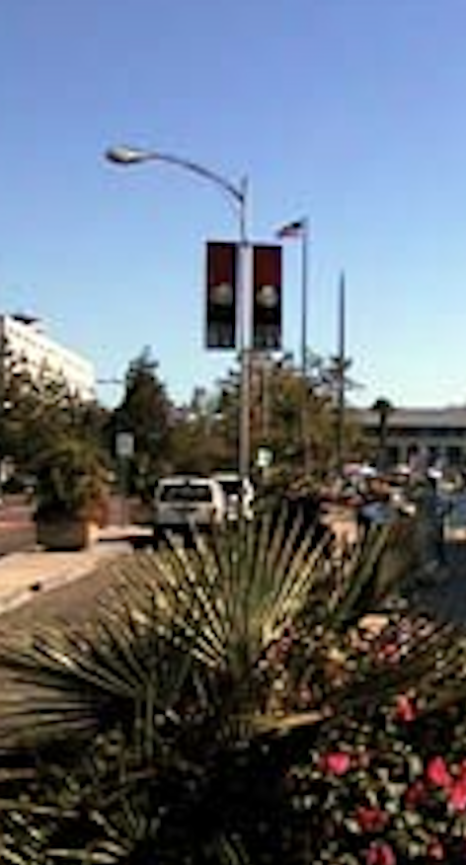
Negative Class: No-Pedestrians
No-Pedestrian

Slide 30
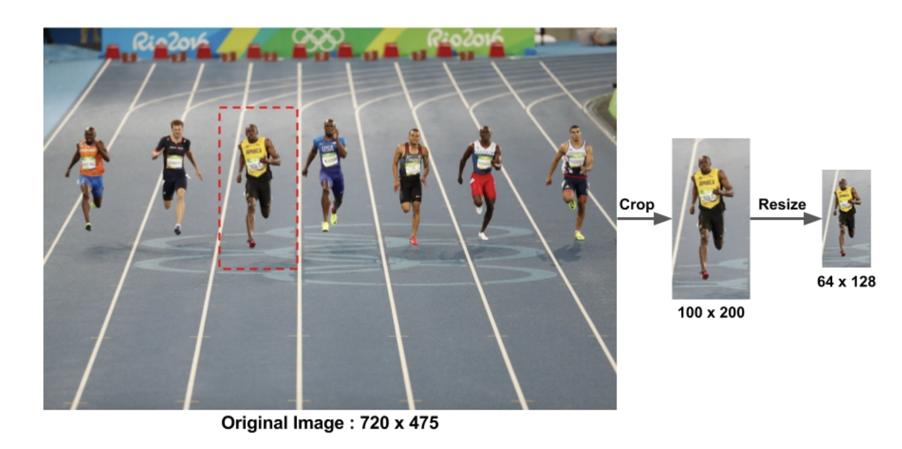
Construction of the Dataset: Positive Class

Slide 31
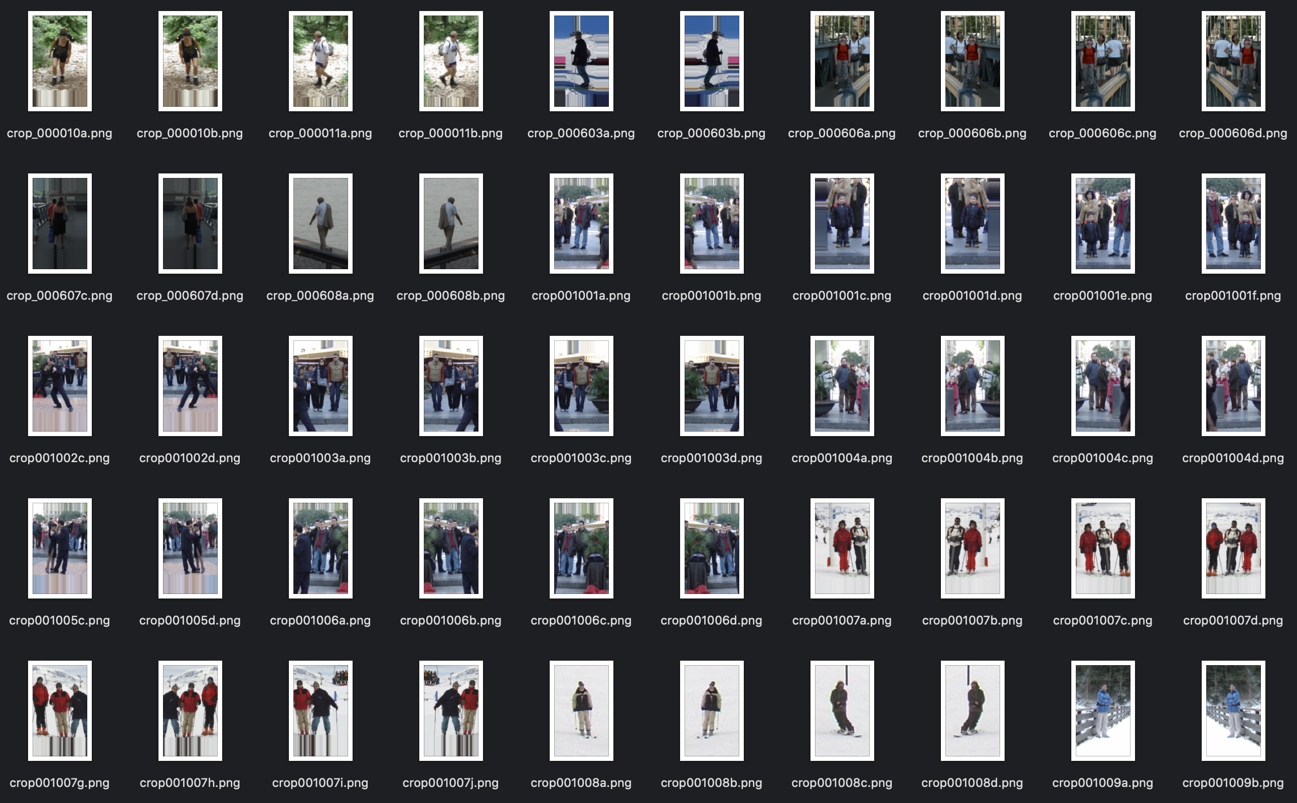
Positive Class: Pedestrians

Slide 32
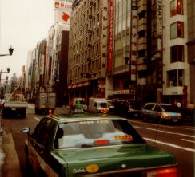
Construction of the Dataset: Negative Class

Slide 33
Construction of the Dataset: Negative Class

Slide 34
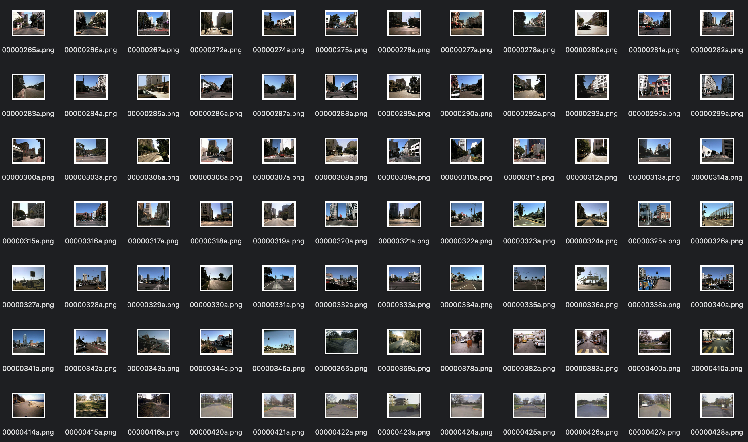
Negative Class: No-Pedestrians

Slide 35
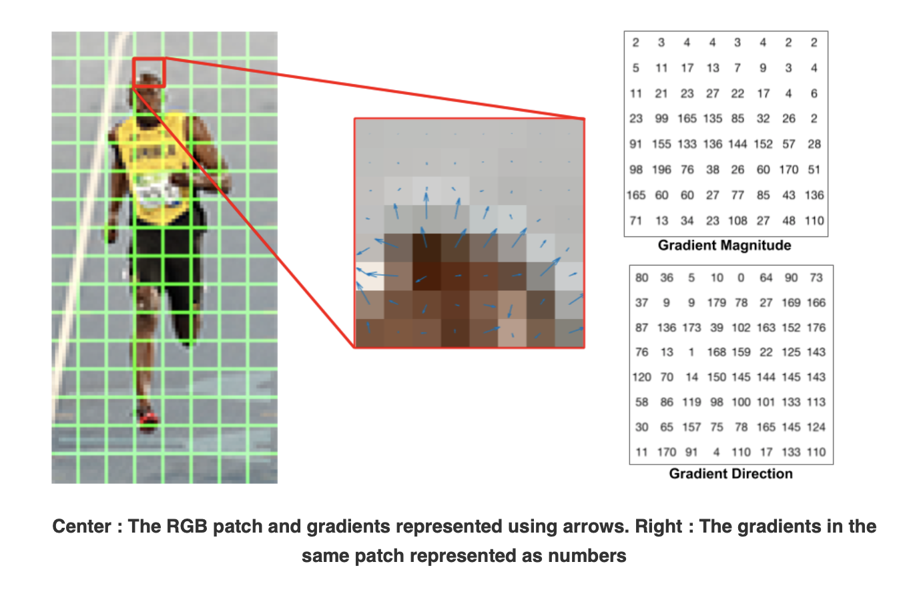
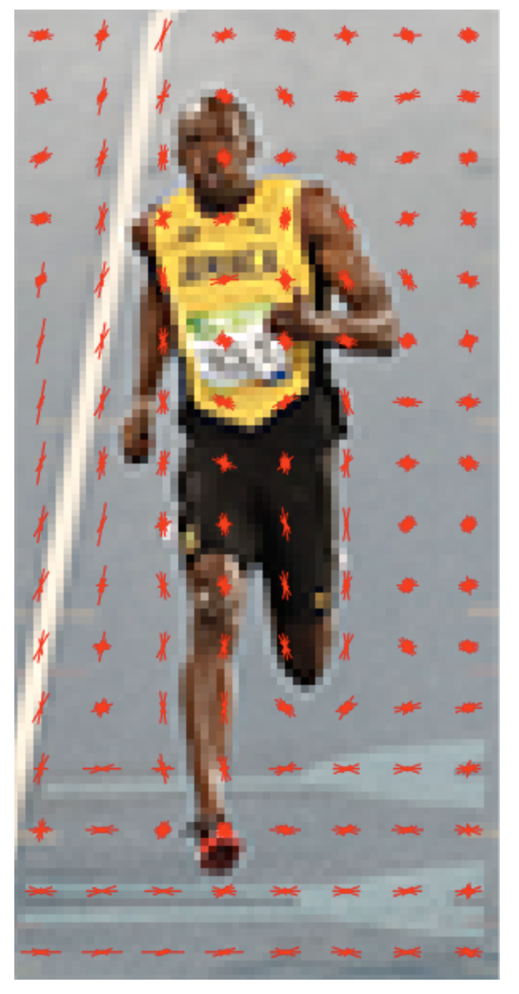
Image:
128 x 64 x 3 pixels
Feature Extraction
Descriptor
3780 elements
https://www.learnopencv.com/histogram-of-oriented-gradients/

Slide 36
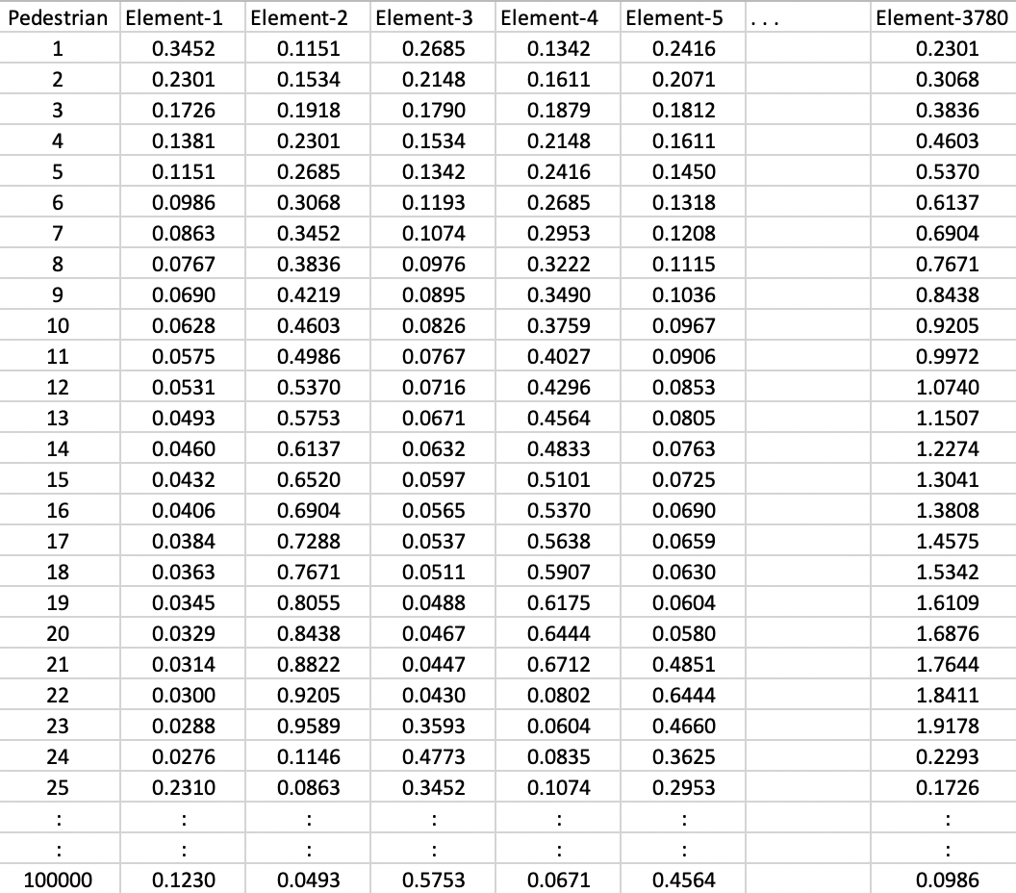
Dataset: Positive Class
Pedestrians

Slide 37
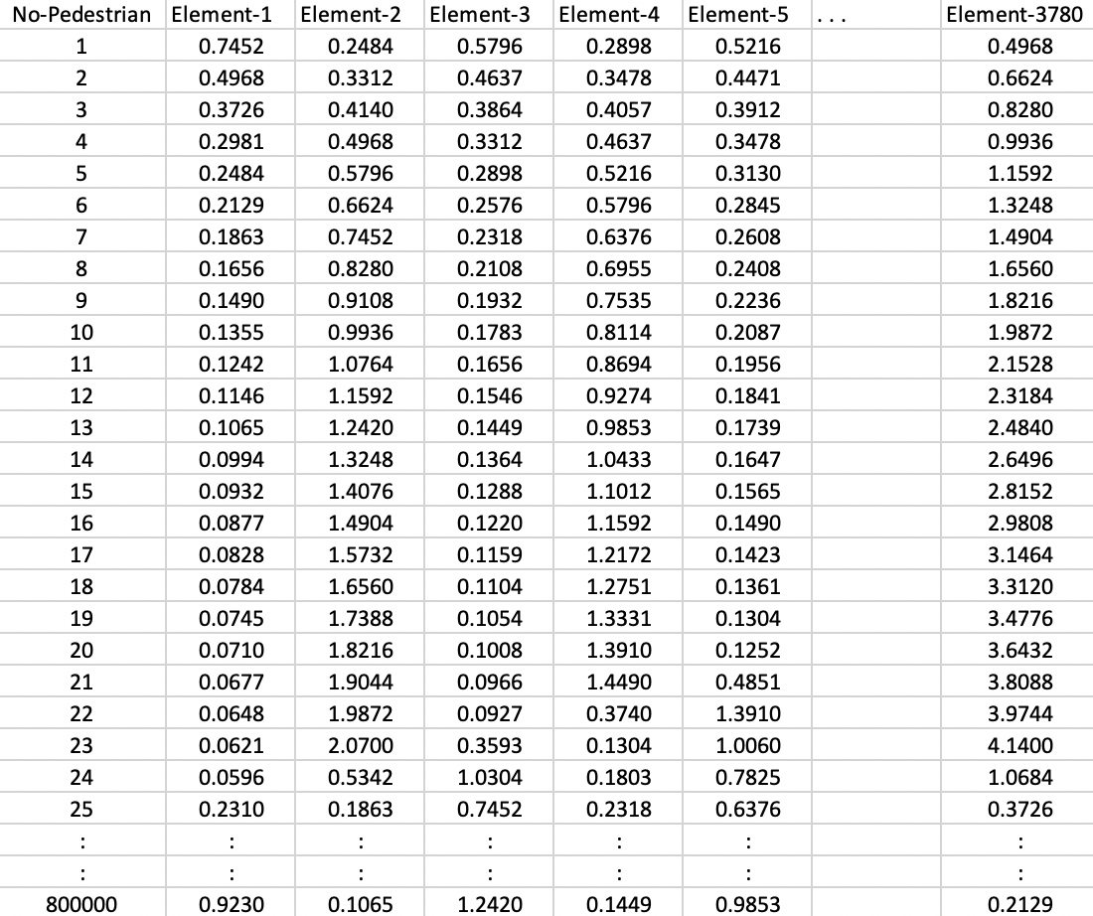
Dataset: Negative Class
No-
Pedestrians

Slide 38
Training
Pedestrians
Design of the
Classifier
Trained
Model
No-
Pedestrians
Dataset

Slide 39
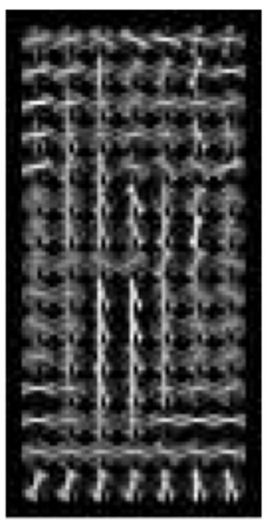
Image:
128 x 64 x 3 pixels
Descriptor
3780 elements
Output:
0 / 1
Pedestrian
Feature Extraction Classification
Using HoG Features Using Trained Model

Slide 40
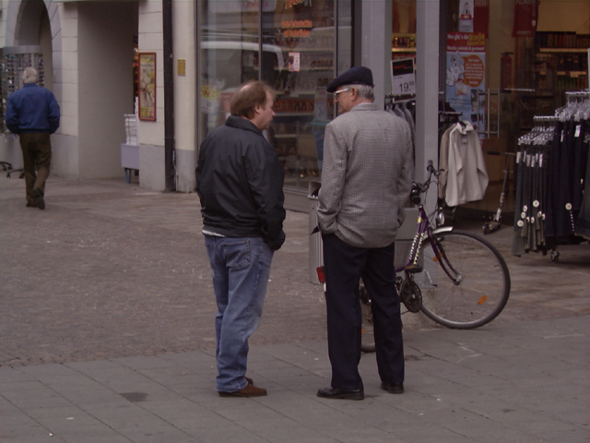
Example

Slide 41
Example

Slide 42
Example

Slide 43
Example

Slide 44
Detection
Example

Slide 45
Example

Slide 46
Detection
Detection
Example

Slide 47
Detection
Detection
Detection
Example

